Slide 1


Slide 2
Checkmate
--modelling of chess

Slide 3
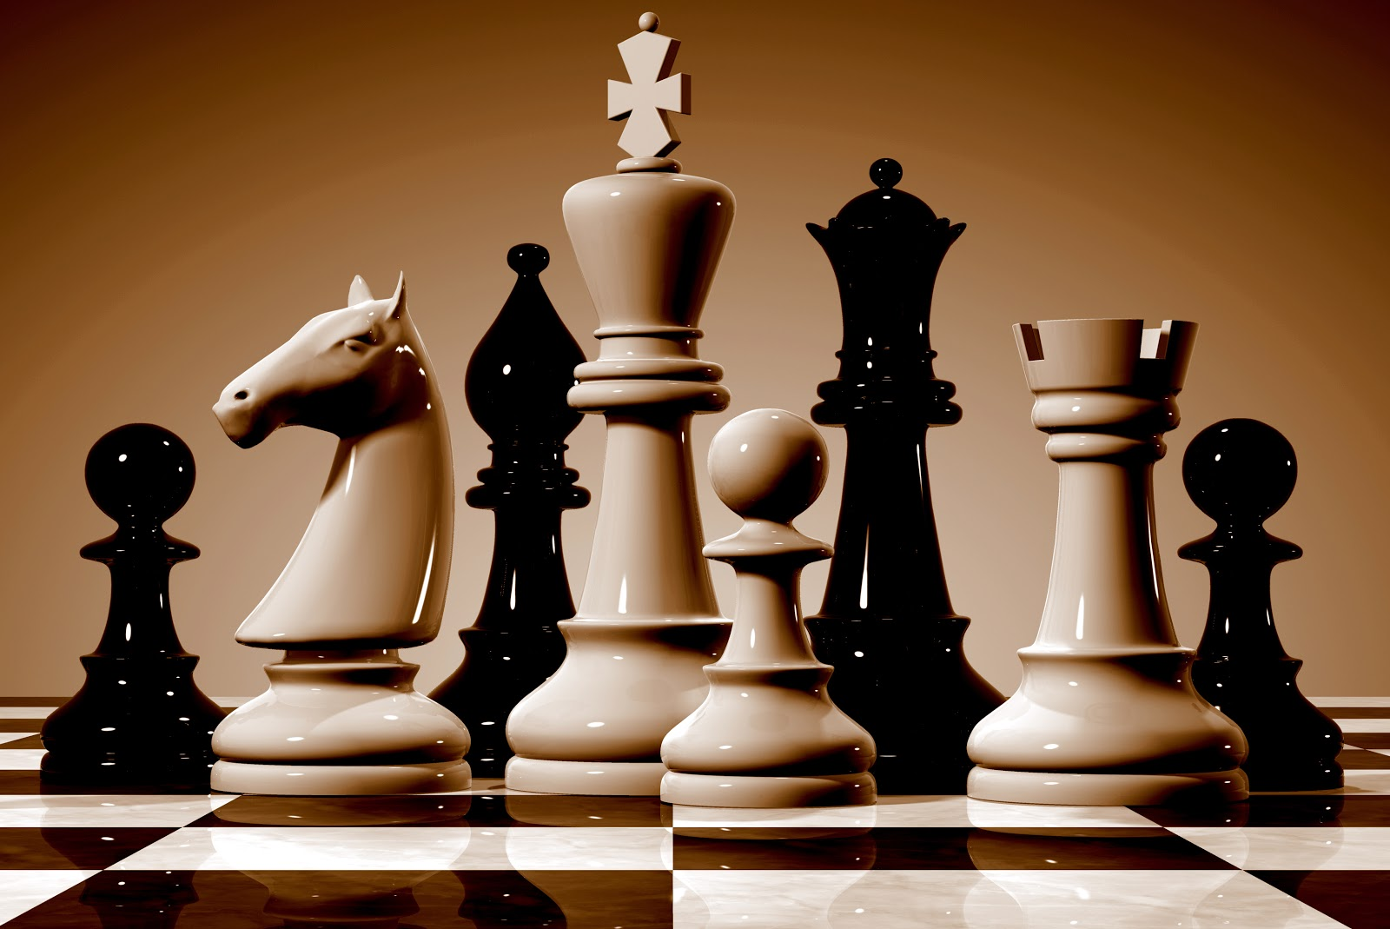
What is chess

Slide 4
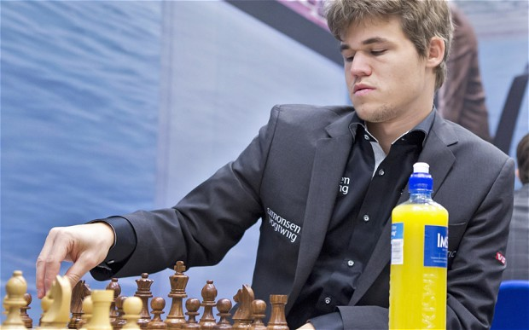
Problem Statement
Model the chess board and solve chess puzzles involving one or two move checkmates
(Not an entire game!!)
Notes:
Not an entire game as we had initially planned

Slide 5
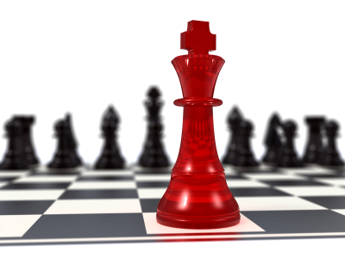
Our initial attempt
Notes:
Homework for entire team => model the movement of a king in a 3 by 3 chess board

Slide 6
Our approach...
WhiteMove()
BlackMove()
Game()
Game() =
Move() =
Plan()
Validate()
Execute()
Notes:
Big picture of the flow of the game

Slide 7
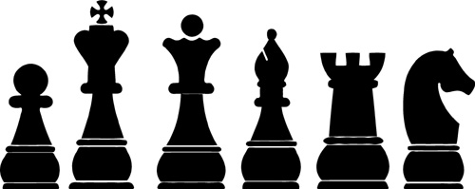
Modelling the pieces
Notes:
Grouping them on commonality of their movements

Slide 8

Modelling the pieces

Slide 9
Modelling the pieces
Notes:
Move Continuous, Move Once

Slide 10
Modeling process: moveContinuous
Move One Step
EndMove [ ] MoveAgain
MoveContinuous =

Slide 11
Modeling process: moveOnce
Move One Step
EndMove
MoveOnce =
Notes:
We realised that the pawn was special…

Slide 12
Modelling the pieces

Slide 13
Modelling the pieces

Slide 14
Modelling the pieces
Notes:
Group it into its own group

Slide 15
Modeling process: movePawnOnce
MoveUpOnce [ ] MoveUpTwice [ ] EatDiagonal
EndMove
MovePawnOnce =

Slide 16
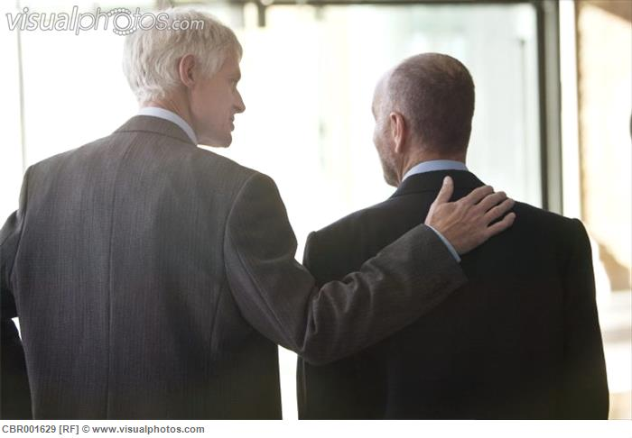
Demo on PAT

Slide 17
Moving Forward (like a pawn)
Modelling a check
Validating a move (uses the above)
Solution to one-move-mate
Hopefully… two-move-mate

Slide 18
Disclaimer
No special moves like:
Castling (Queen or King)
En Passant (You don’t have to know it…)
Promotion

Slide 19
Summary
What is chess
Modeling process
Overall picture
Movement of pieces
MoveContinuous
MoveOnce
MovePawnOnce
Demonstration and sample
Moving-forward

Slide 20


Slide 21


